Slide 1
CloudCore
Day 3 – Machine Learning Fundamentals in Azure

Slide 2


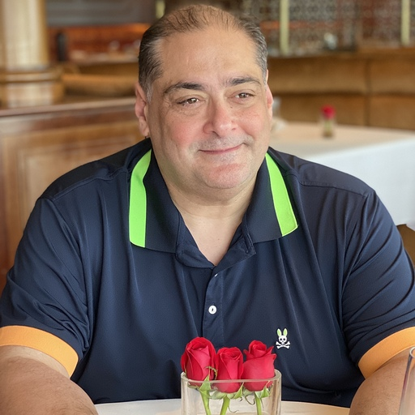
Alain "Lino" Tadros is a partner architect at Solliance on AI, Machine Learning and IoT for the last 4 years.
Lino provides world-class consulting, training, and software development for small, medium, and enterprise level businesses. Lino started his career in 1990 as a well-respected member of the development team at Borland for Delphi and C++Builder.
He has been awarded Microsoft MVP status 15 years in a row for his numerous contributions to the C# community and currently is recognized as a Microsoft Regional Director. Lino is also an expert in AI & Machine Learning, IoT, .NET, Azure, ASP.NET, MVC, iOS, Android, Xamarin, Sitefinity and many testing solutions.
Lino is an industry renowned speaker and has given numerous presentations in 53 countries since 1994. He currently sits on the Board of Directors of 4 Silicon Valley corporations.
You can regularly catch Lino on his LiveStream on Twitch at https://twitch.tv/linotadros
Lino Tadros
Cloud Solutions Architect
lino@solliance.net

Slide 3

Ciprian Jichici is the Chief Data Scientist of Solliance, one of the top worldwide Microsoft AI partners.
He is recognized internationally as a Microsoft Regional Director and a Microsoft Most Valuable Professional for Artificial Intelligence and Quantum Computing.
Cloud Computing, Artificial Intelligence, and Machine Learning are some of the key areas of his expertise spanning 20+ years of IT.
Ciprian is also very passionate about quantum physics and consequently, about quantum computing.
Ciprian Jichici
Chief Data Scientist
ciprian@solliance.net

Slide 4

Day 3 Rundown
Timeframe | Activity | Engagement
7:30 – 8:00 | Virtual check-in
8:00 – 9:00 | Machine Learning Fundamentals in Azure
9:00 – 11:15 | WDS: Machine Learning | Interactive Discussion
11:15 – 12:00 | Lunch
12:00 – 14:00 | Team Challenge: Machine Learning PoC | Interactive Discussion | Hands-on
14:00 – 14:15 | Wrap Up the Day

Slide 5
Day 3 – We are here
Timeframe | Activity | Engagement
7:30 – 8:00 | Virtual check-in
8:00 – 9:00 | Machine Learning Fundamentals in Azure
9:00 – 11:15 | WDS: Machine Learning | Interactive Discussion
11:15 – 12:00 | Lunch
12:00 – 14:00 | Team Challenge: Machine Learning PoC | Interactive Discussion | Hands-on
14:00 – 14:15 | Wrap Up the Day

Slide 6
Agenda
Fundamental Concepts & Patterns
Fundamental Services
Machine Learning Operations
Azure Machine Learning

Slide 7
Fundamental Concepts & Patterns

Slide 8

Image credit: https://developer.nvidia.com/deep-learning

Slide 9
The Pre-Built and Custom AI Spectrum
Pre-Built AI
Custom AI
Azure Cognitive Services
Azure Machine Learning
Pre-built models
Custom models
Models are pre-trained using Microsoft supplied data
Models “customized” with your data
Models tailored to your scenario and your data

Slide 10
The Data Science Process
Collect Data
Prepare Data
Train Model
Evaluate Model
Deploy Model
Re-train
Model
Notes:
Collect Data
Prepare Data
Perform data wrangling to get the data in a format suitable for analysis
Explore and understand the data
Identify or create the features needed for your model
Train Model
Select the algorithm
Prepare training, testing and validation data sets
Iteratively evaluate model to identify best performing version and sanity check outcome
Evaluate Model
Run the model thru a final exam using data from your validation data set and see how it performs
Deploy the Model
Package the model and dependencies up for deployment
Use it in a web service or within an API in an application
Measure the ongoing performance of the model
Retrain
As the data environment changes and affect model performance, retrain the model on fresh data

Slide 11
The Data Science Process (Developer Lens)
Collect Data
Prepare Data
Train Model
Evaluate Model
Deploy Model
Re-train
Model
Write Code
Write Queries & Code
Write Code Do some math
Write Code Do some math
Do DevOps

Slide 12
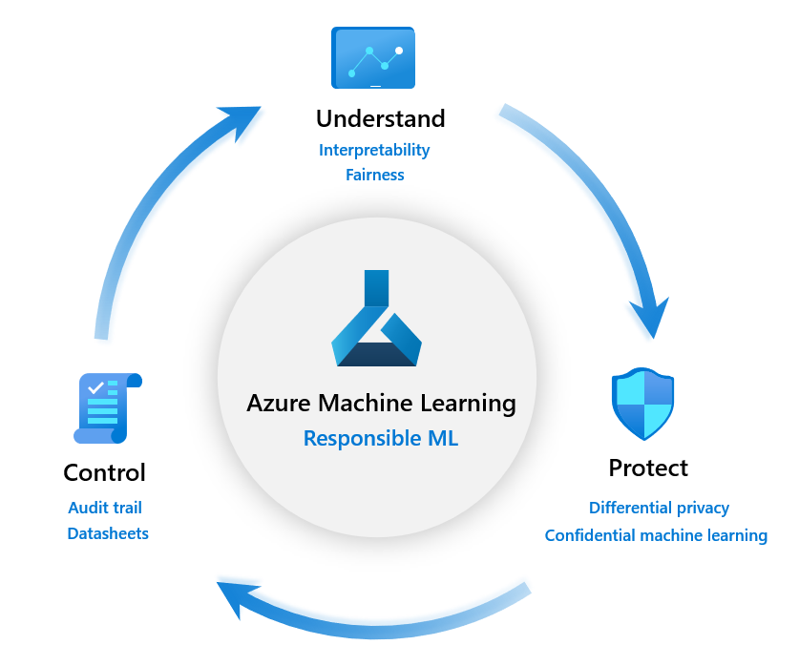

Slide 13
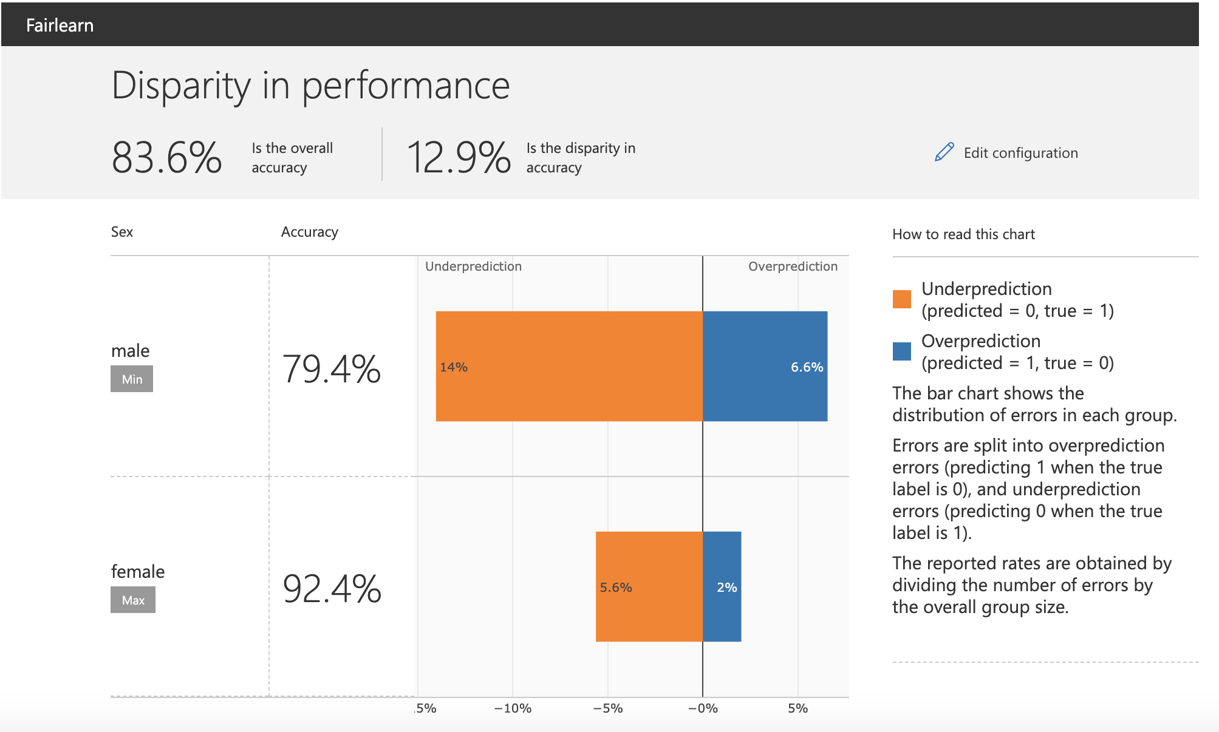
Example: model fairness

Slide 14
Design AI to earn and maintain trust
z
Fairness
Reliability
& Safety
Privacy & Security
Inclusiveness
Transparency
Accountability
Notes:
It boils down to trust
If people don’t trust AI solutions, then they won’t use them and they won’t support their development
These are the values an AI system needs to respect:
Fairness – AI systems should treat all people fairly.
Reliability – AI systems should perform reliably and safely.
Privacy & Security – AI systems should be secure and respect privacy.
Inclusiveness – AI systems should empower everyone and engage people.
These four value are built on a foundation of:
Transparency – AI systems should be understandable.
Accountability - the people who design and deploy AI systems must be accountable for how their systems operate.

Slide 15
The Notebook Paradigm
Collect Data
Retrieve Files
Evaluate
Model
Test Performance
Query SQL Databases
Compare Models
Call Web Services
Validate Model
“Scrape” Web Pages
Visualize Performance
Execute arbitrary:
- Python code
- R code
- SQL queries
- Shell commands
Prepare Data
Explore Data
Deploy
Model
Export Model File
Validate Data
Prepare Job
Clean Data
Deploy Container
Featurize Data
Re-package Model
Notebook
(Jupyter, Azure Databricks)
Train Model
Prepare Training Set
Experiment
Test Model
Visualize Performance

Slide 16
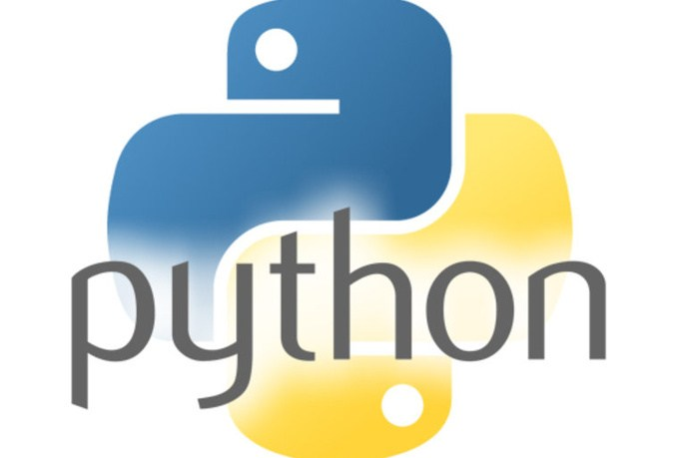
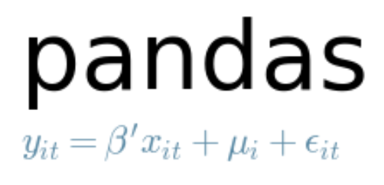

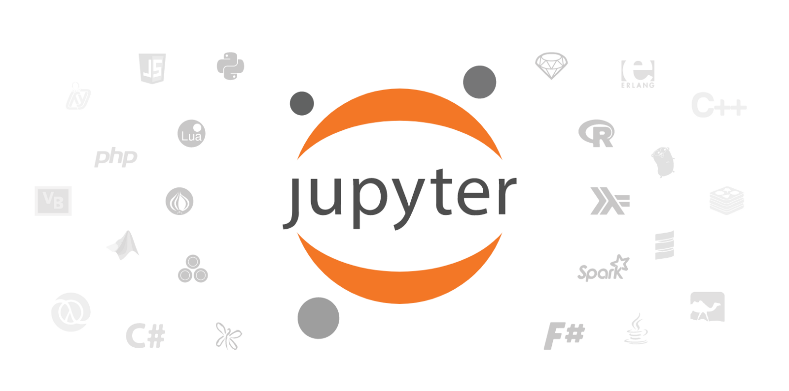

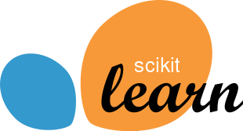
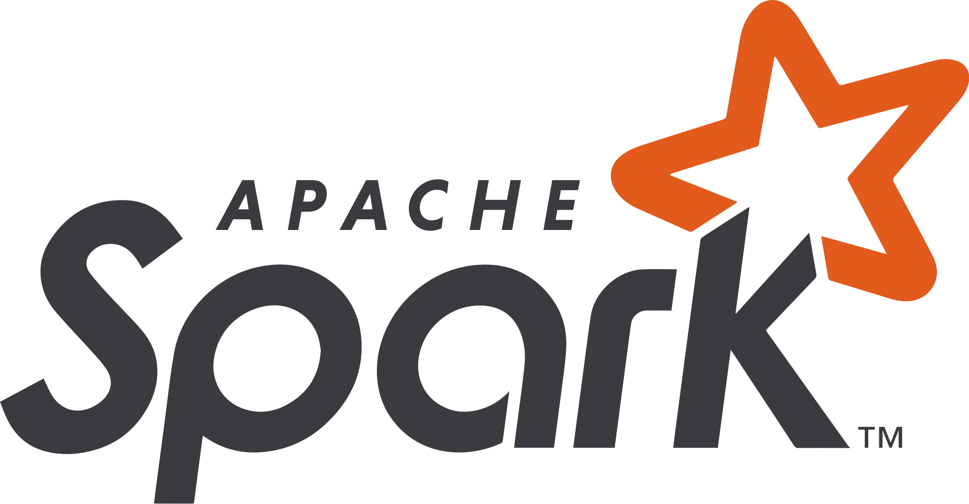
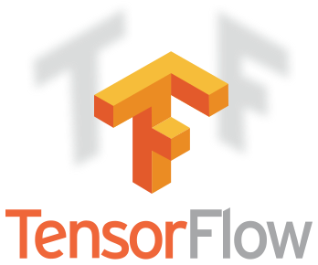
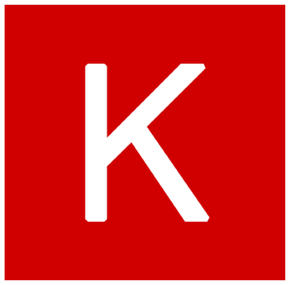

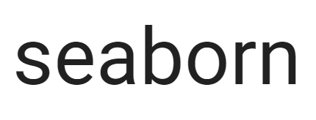
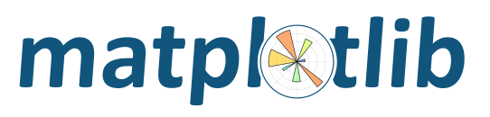

Examples of Tools for Data Science in the Wild
Core frameworks and tools
Machine Learning & Deep Learning
PyTorch
Keras
Visualization

Slide 17
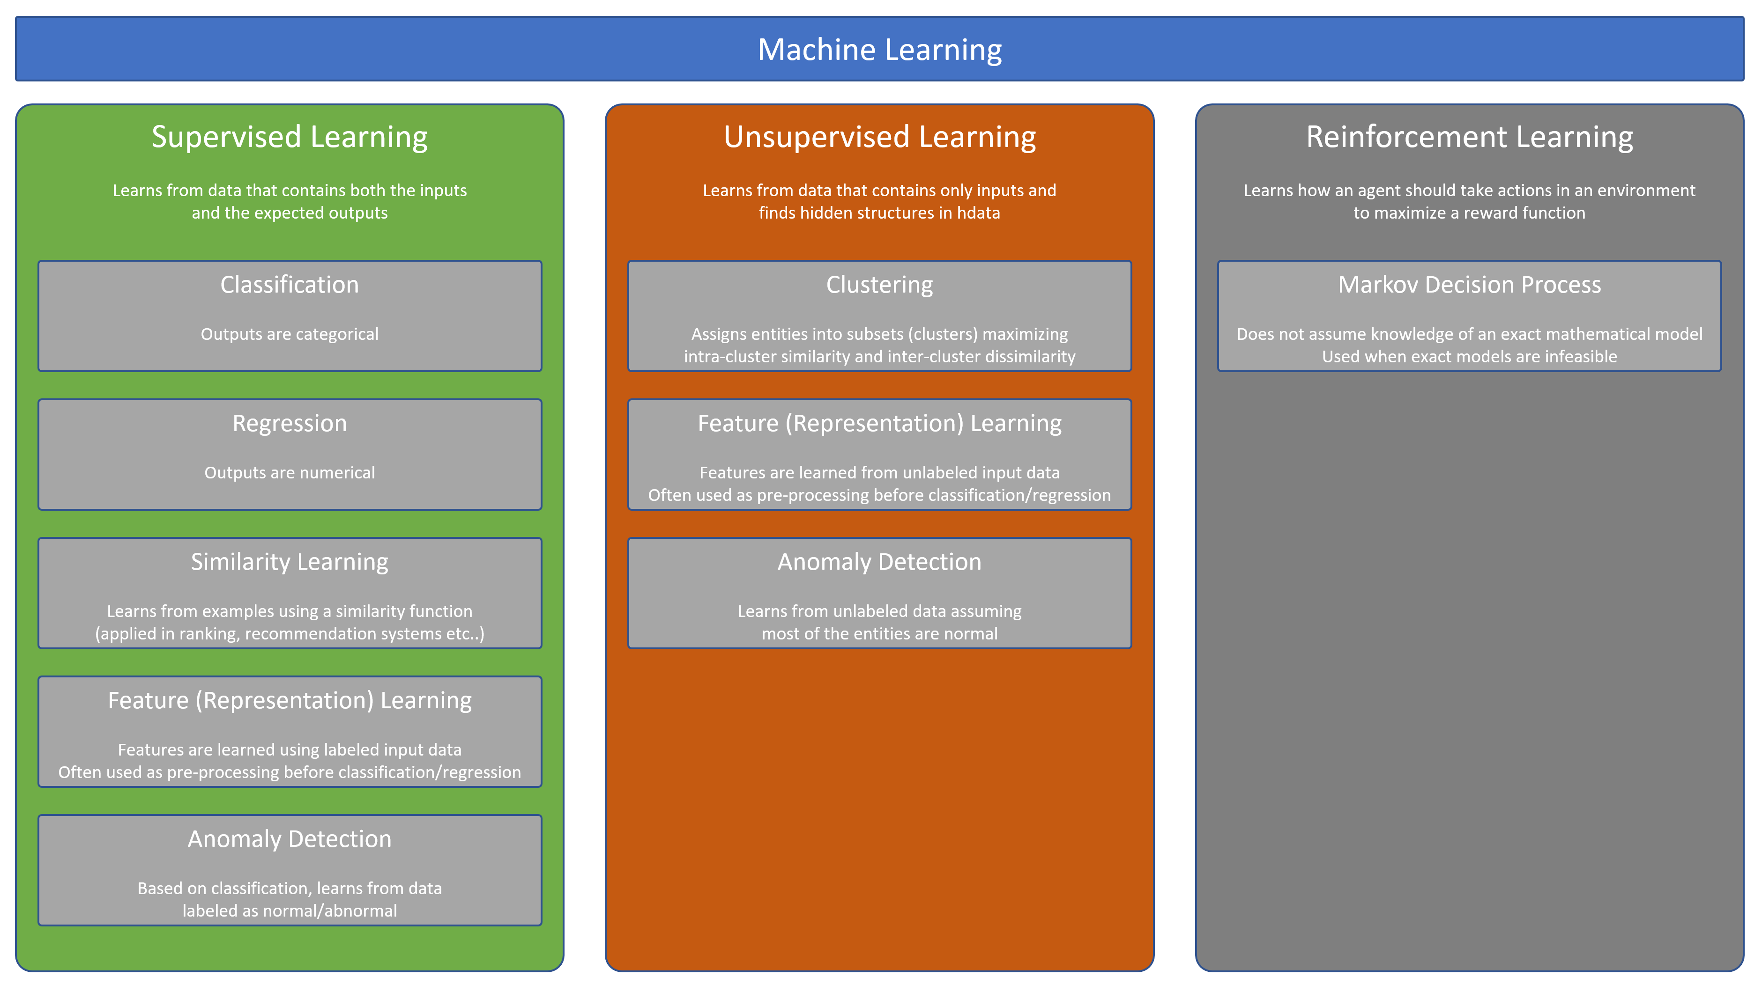

Slide 18
Fundamental Services

Slide 19
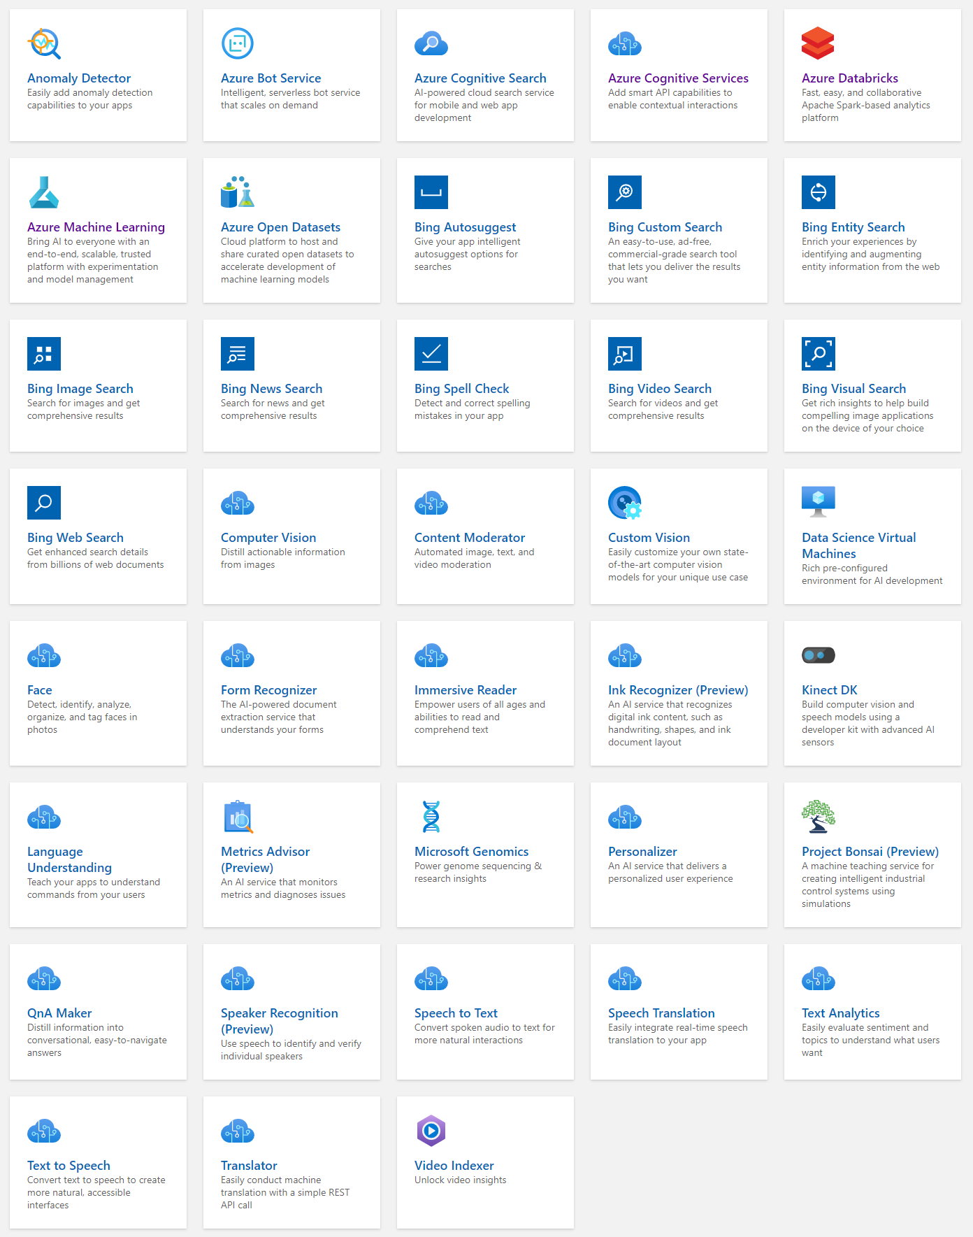
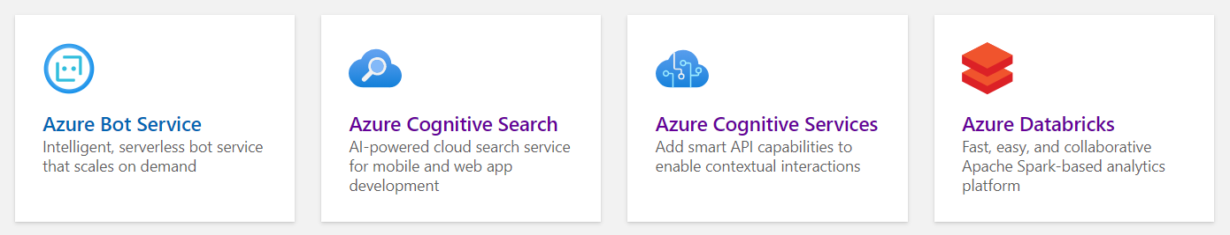
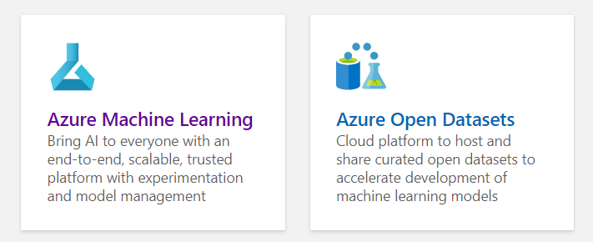
AI + Machine Learning

Slide 20
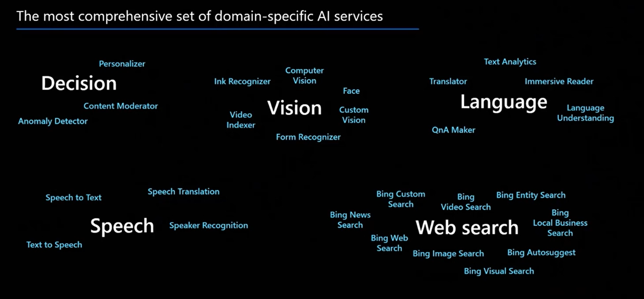
The Pre-built AI/ML Process in the Microsoft World Azure Cognitive Services

Slide 21








The Custom AI/ML Process in the Microsoft World
Prepare data
Train model
Use model
Azure Machine Learning
Azure Synapse SQL
Azure Synapse Analytics
Notebook
SQL Script
Spark Notebook
Train model
T-SQL PREDICT
Prepare data
SQL Script
Azure Databricks
(Spark-based Machine Learning)
Azure Kubernetes Service
Prepare data
Notebook
Web service
Train model
Real-time scoring

Slide 23

Making predictions with T-SQL
Create the model
Register the model
Use the model
Azure Machine Learning
Azure Synapse SQL
Azure Synapse SQL
Notebook
SQL Script
SQL Script
Train Model
Read model
Load from Table
Convert to ONNX
Load into Table
Use Predict
Export to Storage
Insert Predictions
Storage
Models
Notes:
The diagram illustrates the approach the Azure Synapse Analytics enables for machine learning.
Train the machine learning models using notebooks run within Azure Machine Learning. Use the machine learning framework of choice to do so. Model training should always be performed in AML.
Within this notebook, convert the model into the ONNX format and then upload the model to Azure Storage.
From there, run a T-SQL script in Azure Synapse SQL to load the model into a table in the database.
After this, use the model within T-SQL scripts running Azure Synapse SQL by loading the model from the table, and using it with the Predict statement to score data sourced from a table in the database. The scored results could then be used directly or be inserted into a target table for later querying of the predictions.

Slide 24
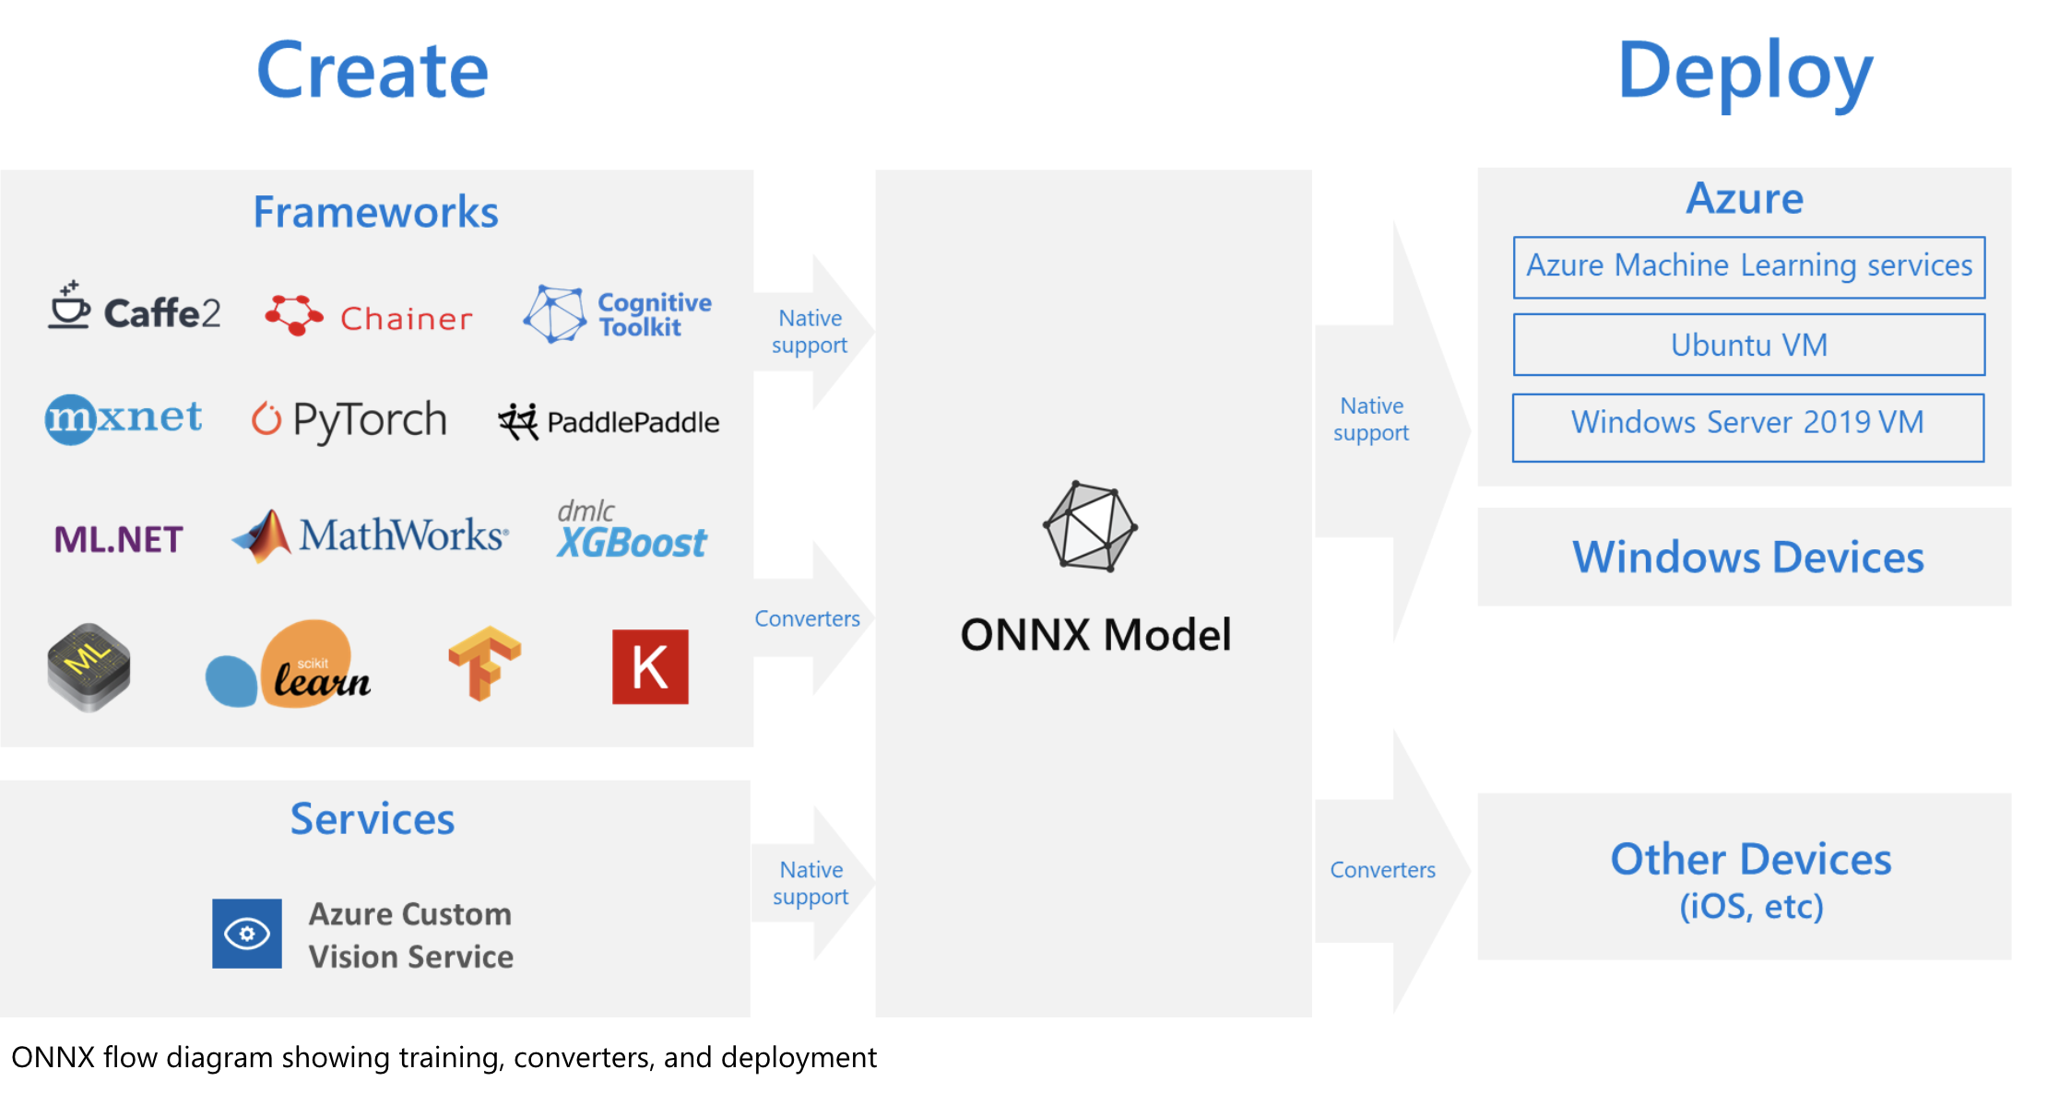
What is ONNX?
Notes:
The challenges of optimizing the performance of machine learning models in production is extremely hard considering the range of hardware capabilities on different platforms such as cloud vs edge, CPU vs GPU etc. and couple that with the variety of frameworks that available for building and training the machine learning models.
To support the idea of providing users the flexibility to train their machine learning models on framework of their choice, and run that model anywhere with optimal performance, is at the core of Open Neural Network Exchange (ONNX) format for representing machine learning models. ONNX is an open format, that is supported by a community of partners, including Microsoft, who create compatible frameworks and tools.
You can create ONNX models from many frameworks, including PyTorch, Chainer, Microsoft Cognitive Toolkit (CNTK), MXNet, ML.Net, TensorFlow, Keras, SciKit-Learn, and more. ONNX Runtime is optimized for both cloud and edge and works on Linux, Windows, and Mac, and it also integrates with accelerators on different hardware such as TensorRT on NVidia GPUs. ONNX models can be deployed to the cloud using Azure Machine Learning and ONNX Runtime. They can also be deployed to Windows 10 devices using Windows ML. They can even be deployed to other platforms using converters that are available from the ONNX community.
The interoperability you get with ONNX makes it possible to get great ideas into production faster. With ONNX, data scientists can choose their preferred framework for the job. Similarly, developers can spend less time getting models ready for production, and deploy across the cloud and edge.
Data scientists: use the framework of their choice to create and train models
Developers: deploy models cross-platform with minimal integration work

Slide 25
Machine Learning Operations

Slide 26
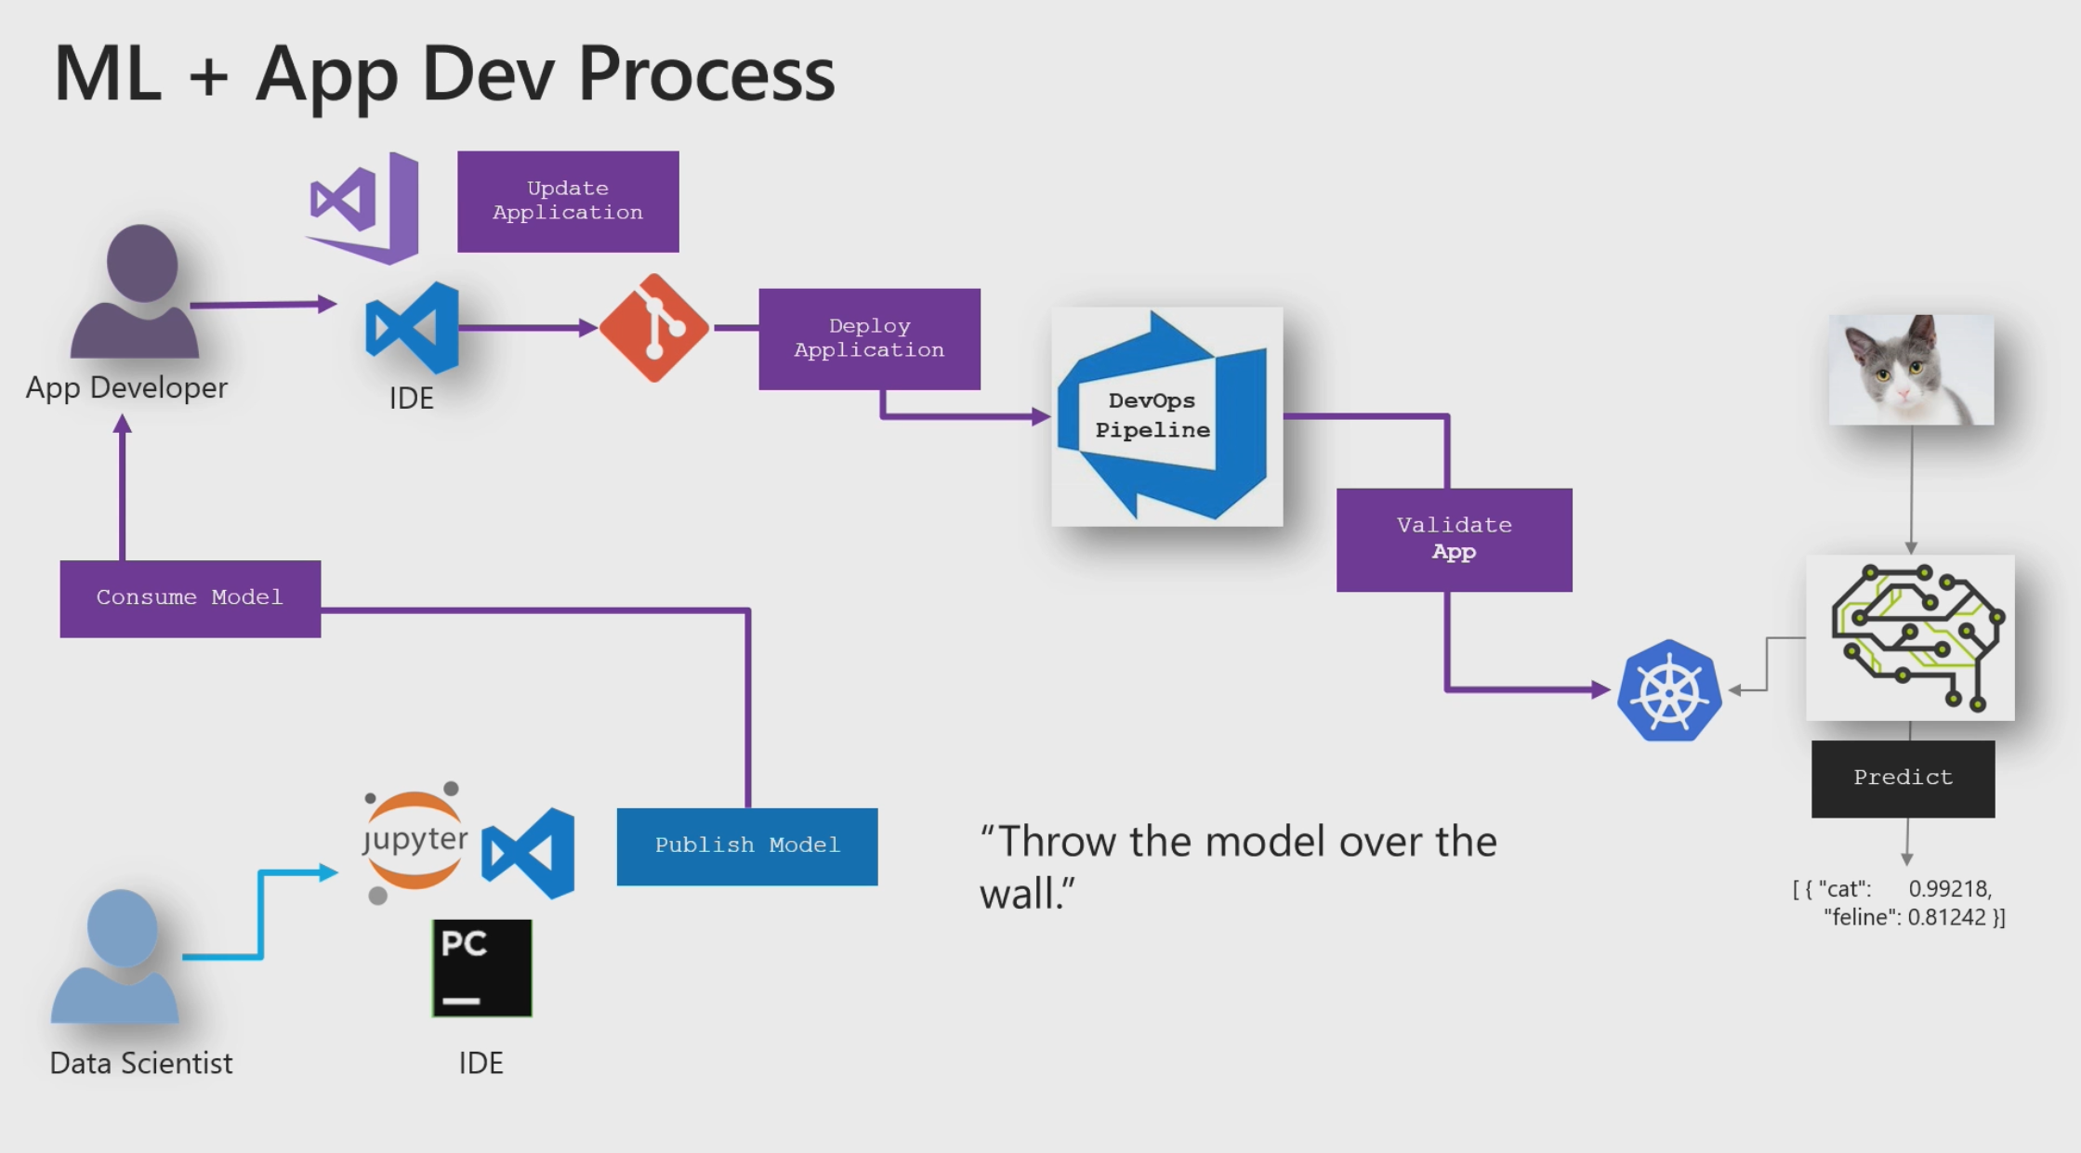

Slide 27
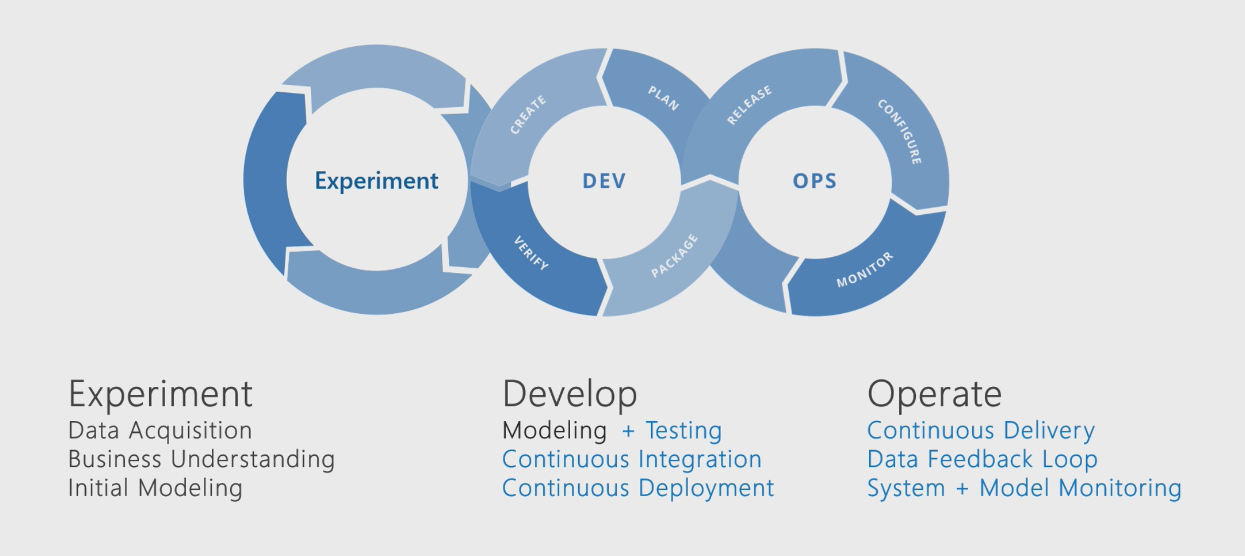
The Machine Learning Lifecycle

Slide 28
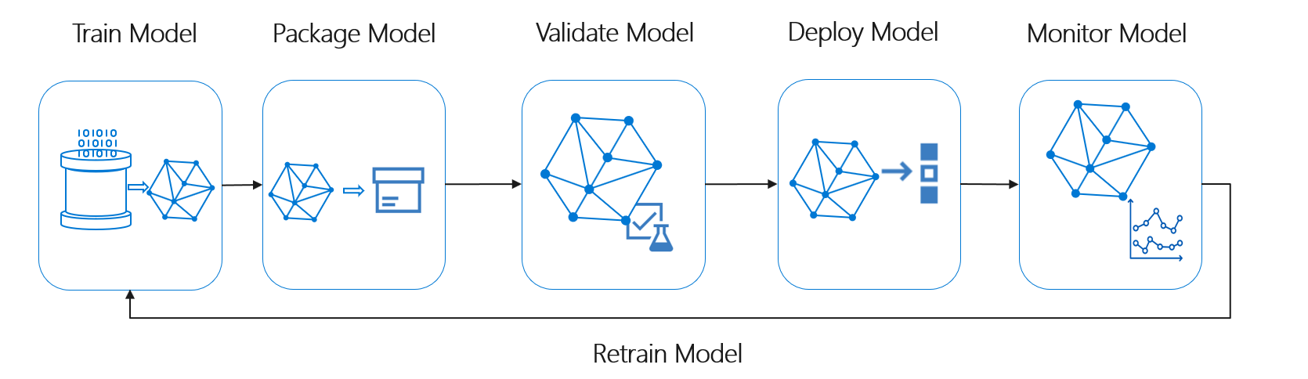

Slide 29
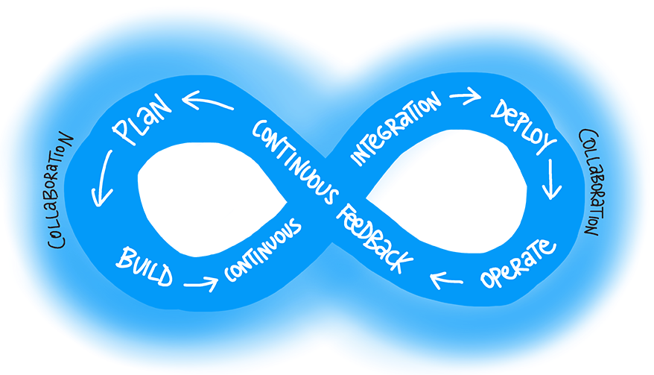
Challenges in ML development
Execute the process
Secure the process
Govern the process

Slide 30
Executing the process
Versioning for both data and code - the source code of the model training process has limited value if it's not also accompanied by the dataset or datasets that were used to create the trained model
Extensive quality checks on trained models - interpretability, fairness, accuracy, and the like.
Extensive quality checks on deployed models - detecting data drift, monitoring, logging, and the like.
Ensuring full traceability, from the result of an inference created in a production environment all the way back to the source code and training data sets used to build a model in the first place.

Slide 31
Securing the process
Identity management across multiple, heterogenous systems (e.g. development environment, production environment, various managed ML services, data sources, etc.).
Controlling access at every step of the lifecycle.
Securing the complex infrastructure required to develop and operate ML models.
Handling privacy, encryption, and confidentiality while still using as much data as possible to develop and operate ML models.
Monitoring, detecting, and reacting to security threats or vulnerabilities.

Slide 32
Governing the process
Defining roles
Managing all processes
Establishing clear responsibilities

Slide 33
Unique challenges of MLOps
Data/model versioning vs. code versioning
Digital audit trail requirements for code + data
Model reuse vs. software reuse
To reuse model might mean fine tune / transfer learn
No model lives forever – re-train on-demand

Slide 34
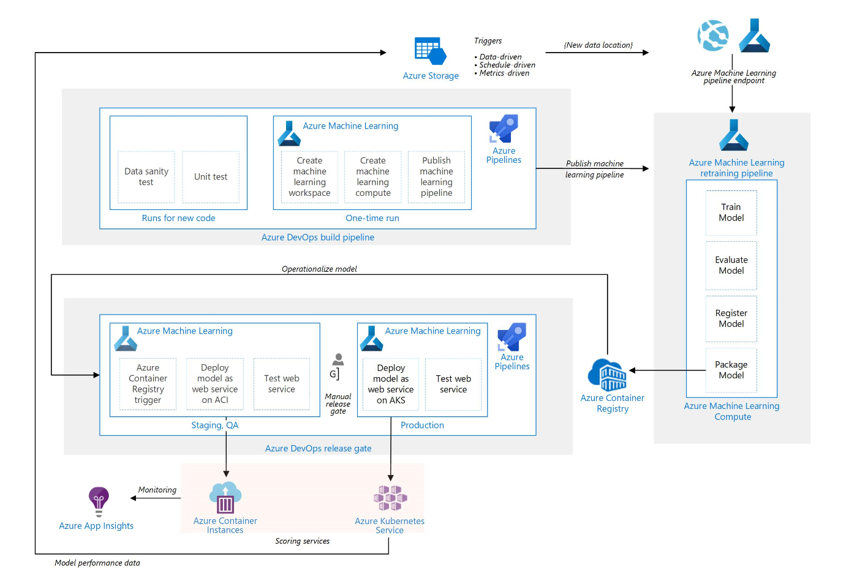
MLOps with AML and Azure DevOps

Slide 35
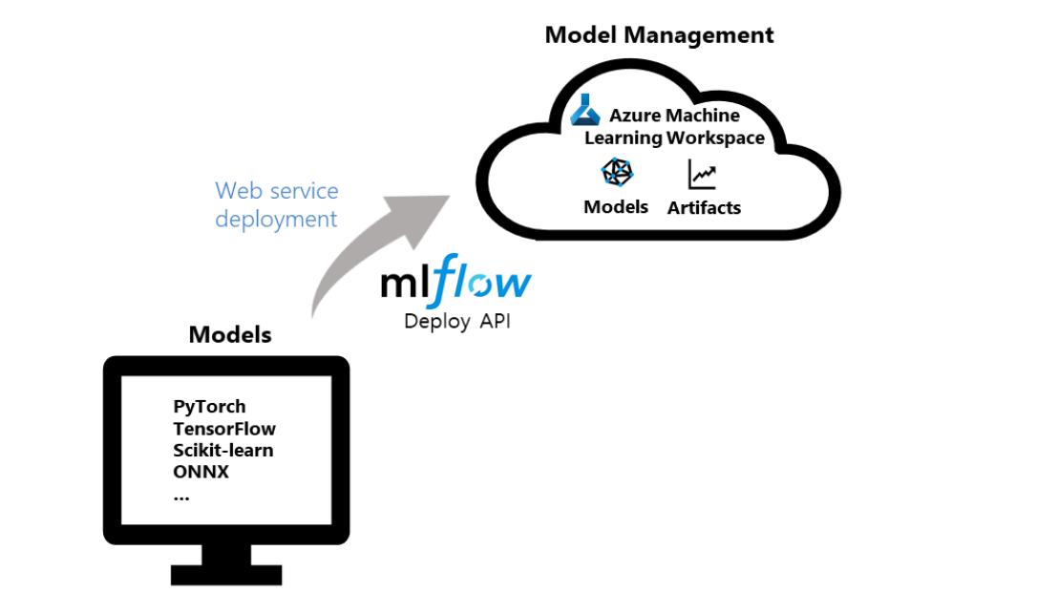
MLFlow with AML Deployment

Slide 36
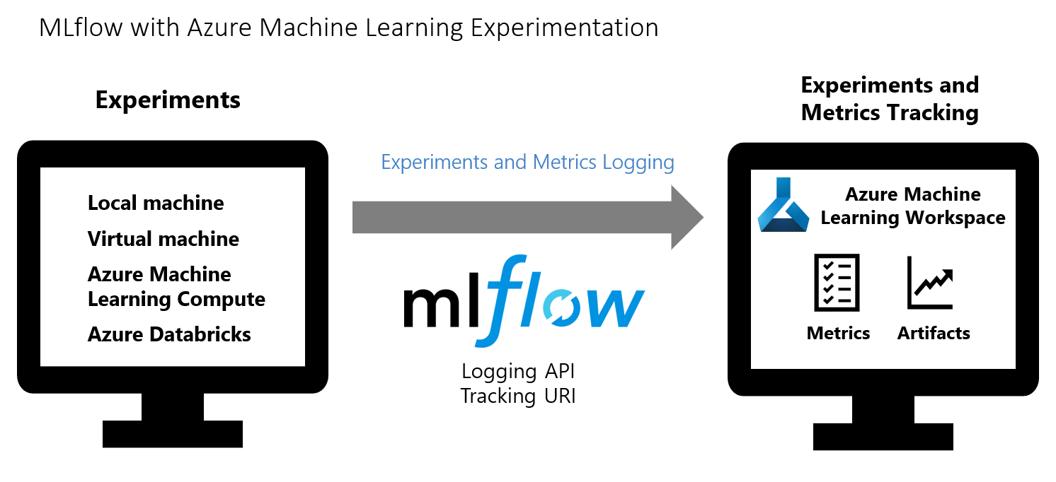
MLFlow with AML Experimentation

Slide 37
Azure Machine Learning

Slide 38
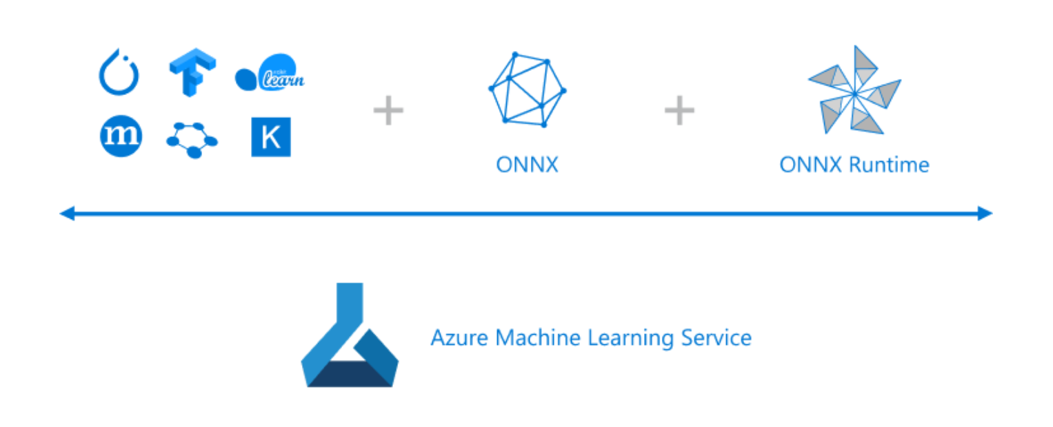
OSS-friendly managed ML services platform

Slide 39
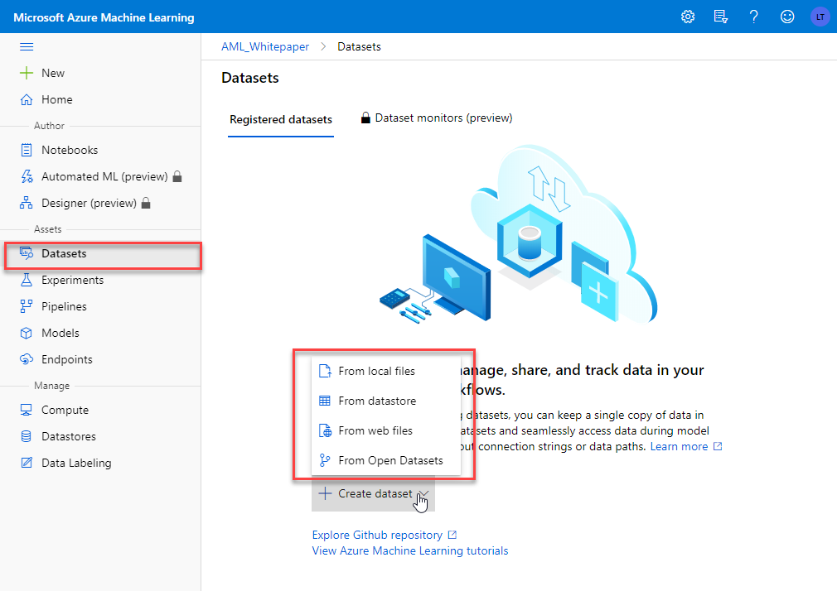
Datastores and datasets

Slide 40
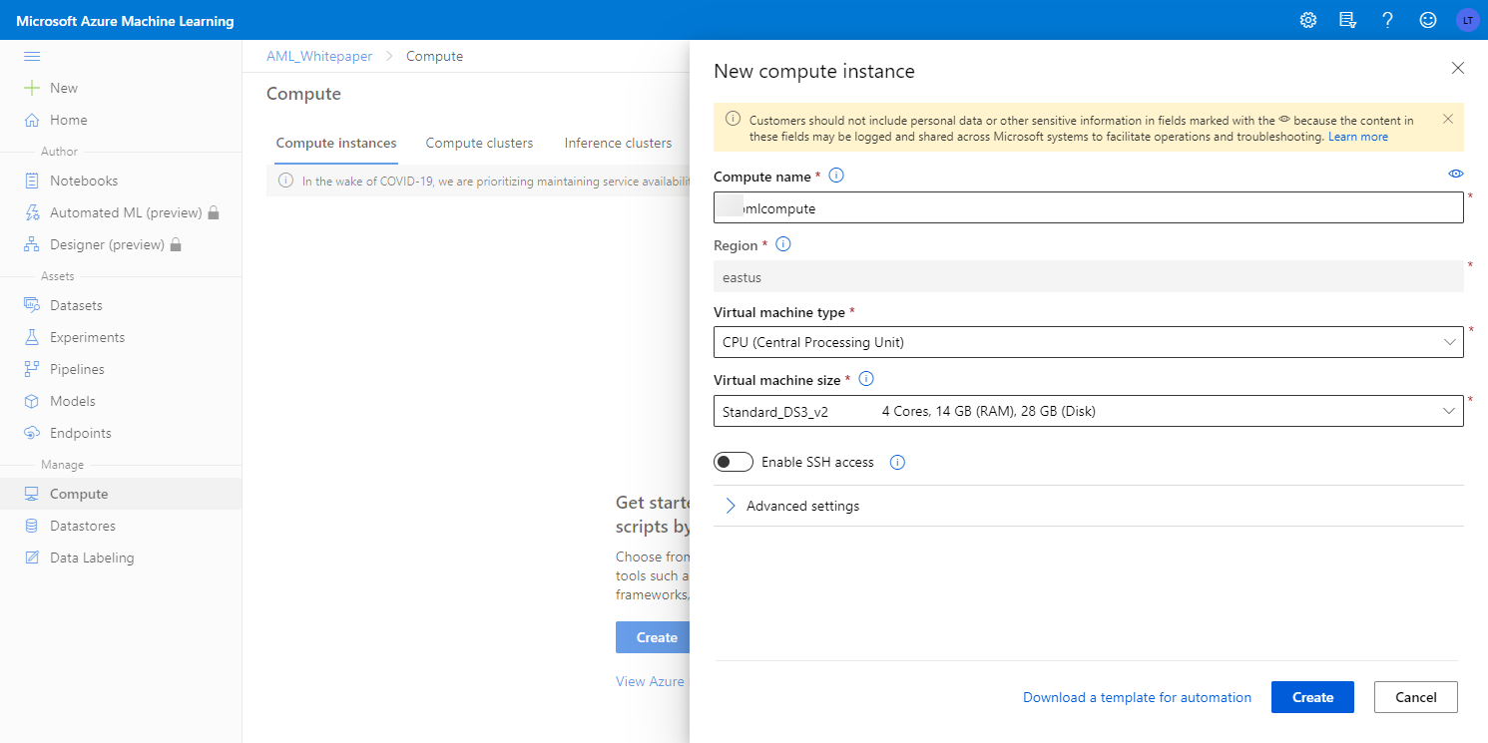
Compute resources

Slide 41
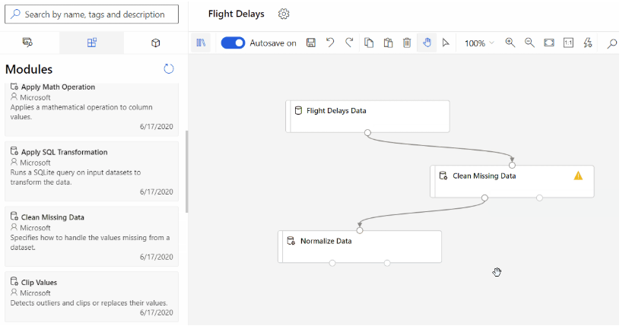
Automate through pipelines

Slide 42
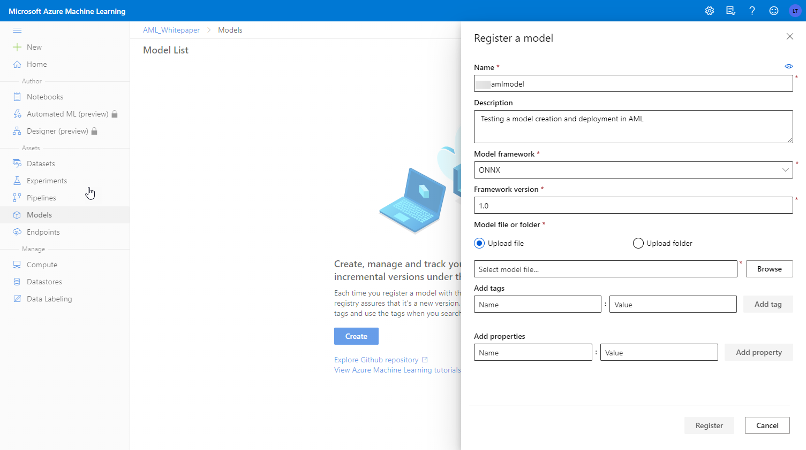
Manage models

Slide 43
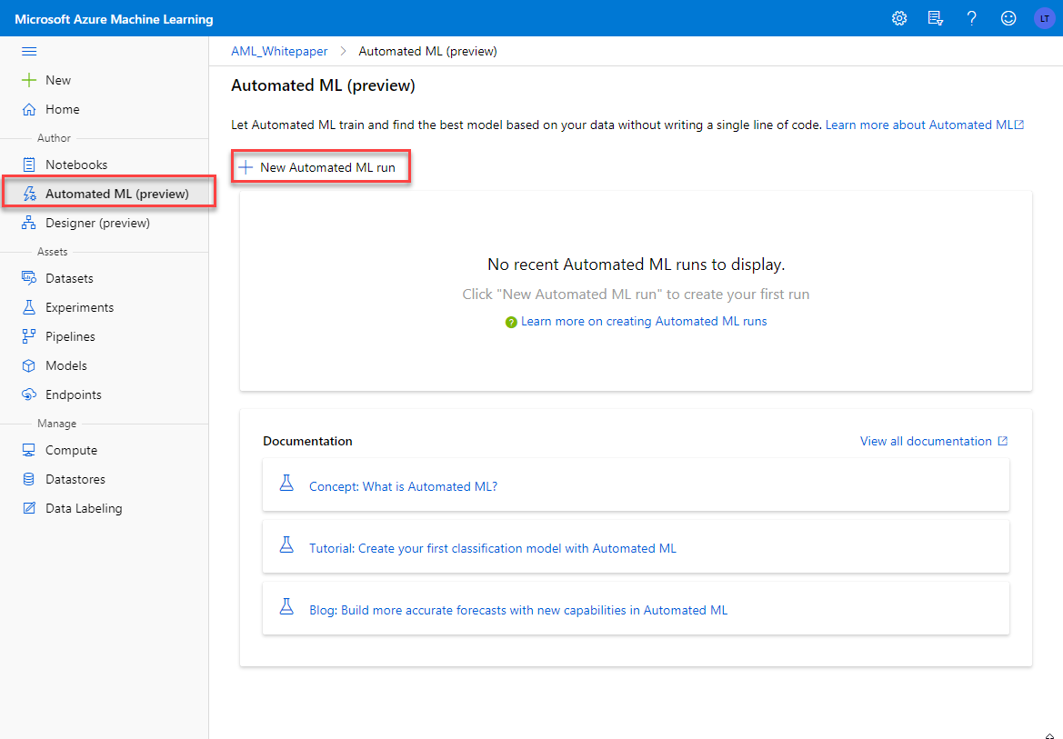
Auto ML

Slide 44
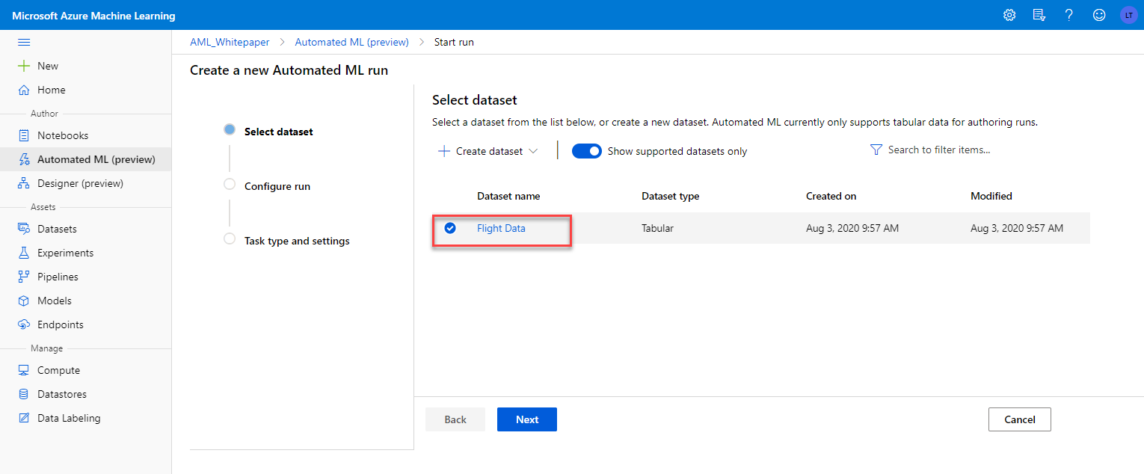
Auto ML

Slide 45
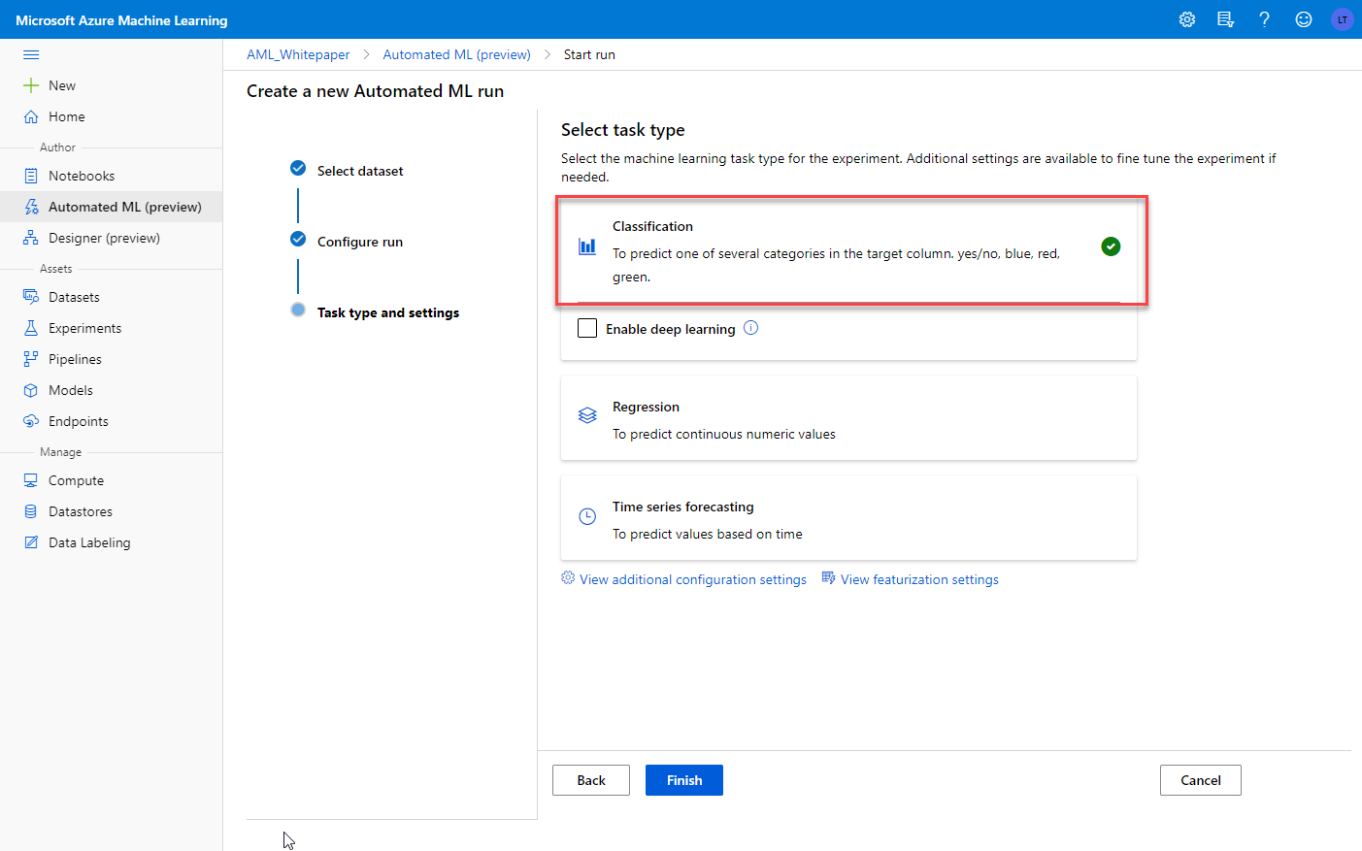
Auto ML

Slide 46
Day 3 – We are here
Timeframe | Activity | Engagement
7:30 – 8:00 | Virtual check-in
8:00 – 9:00 | Machine Learning Fundamentals in Azure
9:00 – 11:15 | WDS: Machine Learning | Interactive Discussion
11:15 – 12:00 | Lunch
12:00 – 14:00 | Team Challenge: Machine Learning PoC | Interactive Discussion | Hands-on
14:00 – 14:15 | Wrap Up the Day

Slide 47
Next: Whiteboard Design Session
GitHub repo for the Whiteboard Design Session:
https://github.com/solliancenet/cloud-core-2020
The WDS material is found under data-ai/day-3/wds

Slide 48
Day 3 – We are here
Timeframe | Activity | Engagement
7:30 – 8:00 | Virtual check-in
8:00 – 9:00 | Machine Learning Fundamentals in Azure
9:00 – 11:15 | WDS: Machine Learning | Interactive Discussion
11:15 – 12:00 | Lunch
12:00 – 14:00 | Team Challenge: Machine Learning PoC | Interactive Discussion | Hands-on
14:00 – 14:15 | Wrap Up the Day

Slide 49
Day 3 – We are here
Timeframe | Activity | Engagement
7:30 – 8:00 | Virtual check-in
8:00 – 9:00 | Machine Learning Fundamentals in Azure
9:00 – 11:15 | WDS: Machine Learning | Interactive Discussion
11:15 – 12:00 | Lunch
12:00 – 14:00 | Team Challenge: Machine Learning PoC | Interactive Discussion | Hands-on
14:00 – 14:15 | Wrap Up the Day

Slide 50
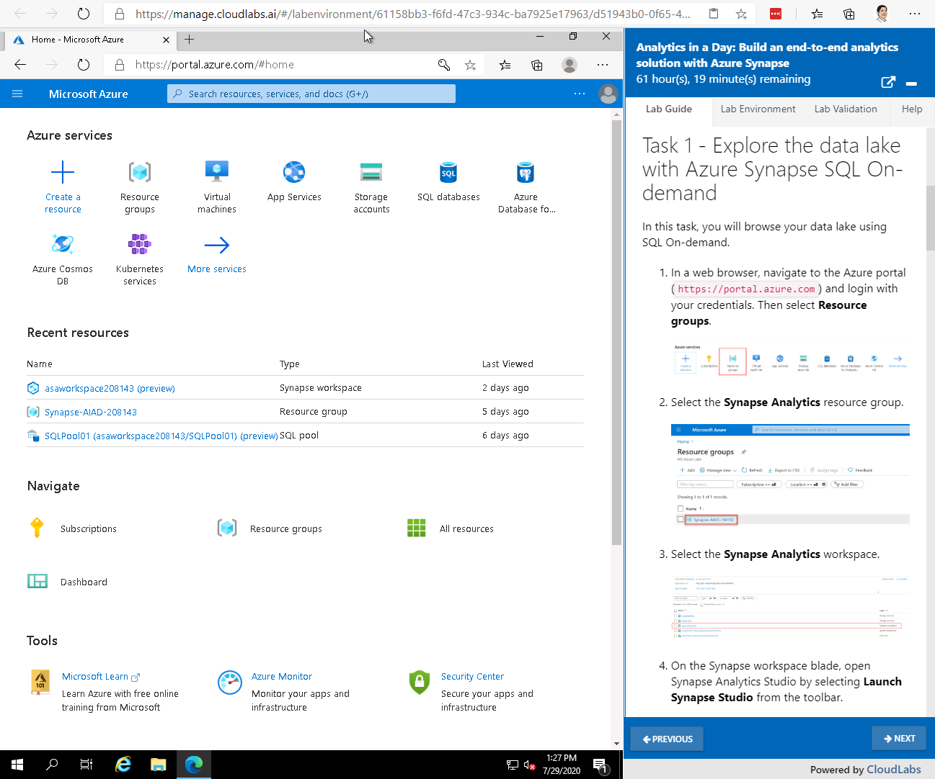
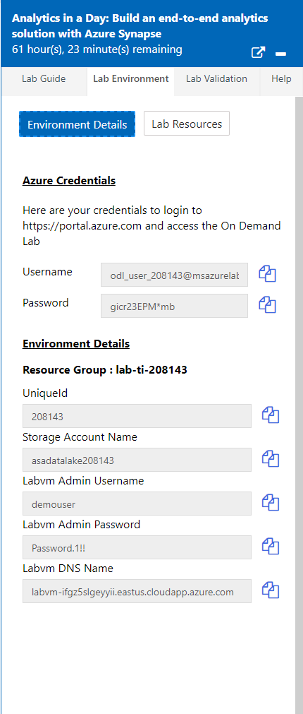
Next: Lab Experience
Lab can provide a VM with software preinstalled
Each attendee has a dedicated lab environment:
https://manage.cloudlabs.ai/#/odl/6029acfe-d79e-4077-b8cb-96c44626ce0a/79d95799-89dd-469b-b2eb-ef92fbd531ad
Lab Guide is in markdown
and pulled from GitHub
Each link is unique to the attendee.
GitHub repo for the lab:
https://github.com/solliancenet/cloud-core-2020
The challenge guide is found under data-ai/day-3/challenge
Azure credentials and other environment details in Lab Environment tab

